Slide 1

A Day in the Kremlin
Team 19

Slide 2
Contents
Introduction
Our Game
Game Demo
The Making of the Game
Code
Selling Points

Slide 3
Introduction
Our current generation has lost a lot of hope
One dream is to escape the world of Capitalism
We let the youth of today simulate that dream with our game
We wanted to bring back communism

Slide 4
Our game
Single player text based adventure game based in Soviet Russia.
You are Joseph Stalin’s Aid, and the aim is to survive the day by completing tasks set by Stalin himself.
Dark, brutally hard game which will frustrate you into playing more.
A morbid game with humour thrown in to take the pain away

Slide 5
Game Demo

Slide 6
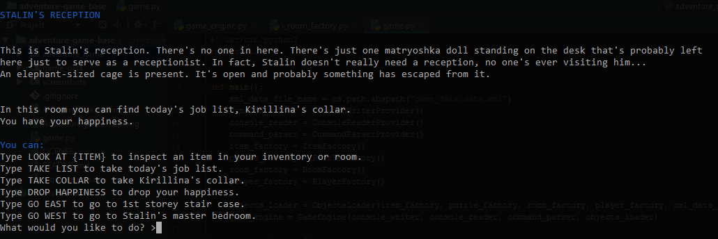
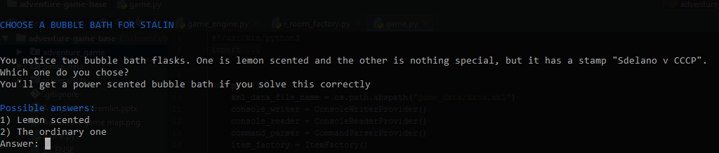

Slide 7
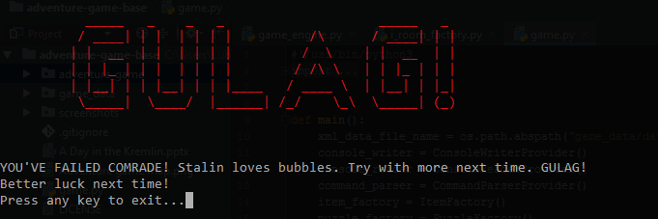
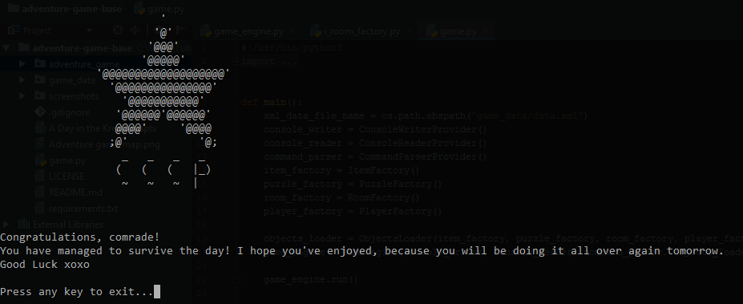

Slide 8
The Making of the Game
Story focus
GitHub was our main means of collaboration
Group Meetings, Emails
Object Orientated Approach
XML

Slide 9
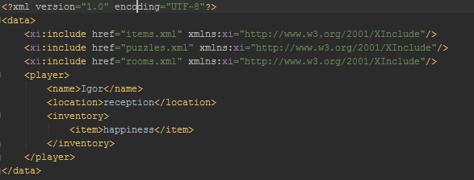
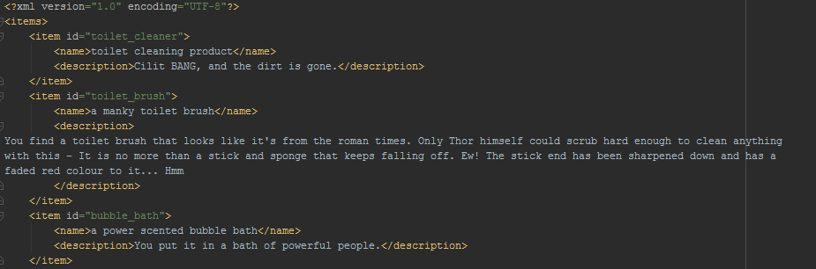
Code
Objects are stored in XML files

Slide 10
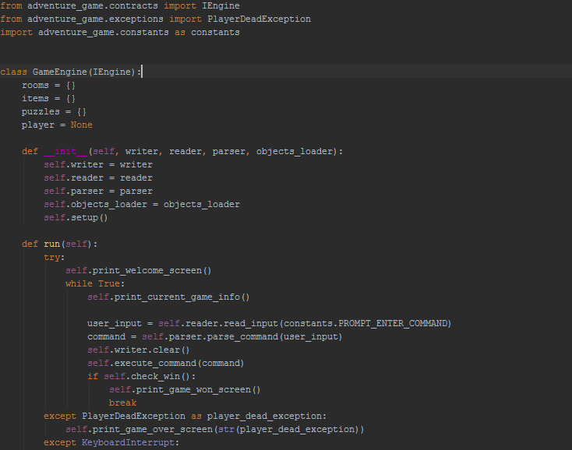
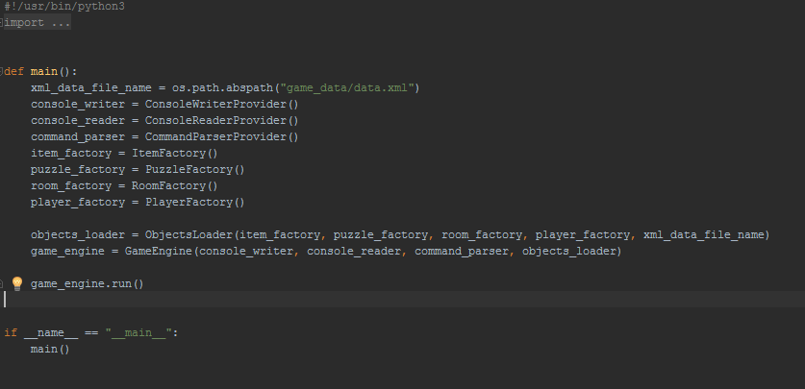
Code
The game engine is responsible for handling all of the logic

Slide 11
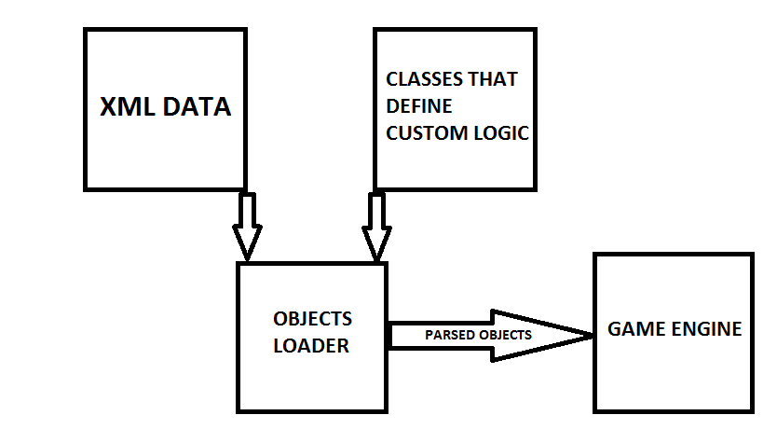
Code
How does the XML become a game?

Slide 12
Code
Third-party libraries used:
BeautifulSoup (MIT) for parsing the XML
LXML (BSD) for parsing the XML
Colorama (BSD 3-clause) for colorful console output

Slide 13
Selling Points
First of its kind
Easily expandable and adaptable
Room for sequels
Anyone can play

Slide 14
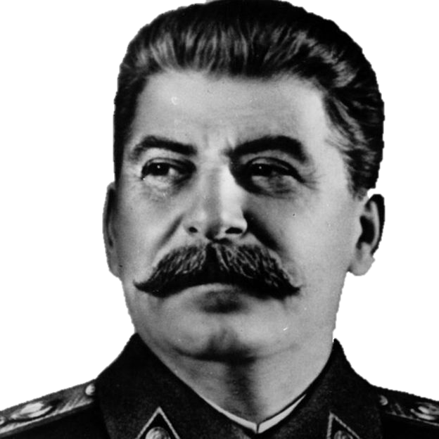
Any Questions?

